Slide 1

Deep Convolutional Neural Network
for Malaria Parasite Detection
Presented By:
Md Yamin Haque
Roll: 1603007
Department of CSE
Supervised By:
Mahit Kumar Paul
Assistant Professor
Department of CSE
Department of CSE,
Rajshahi University of Engineering and Technology

Slide 2
Table of |  |  | Page
 | I | Research Background & Motivation | 3
 | II | Literature Review | 5
 | III | Methodology | 9
 | IV | Performance Analysis | 16
 | V | References | 22
Contents

Slide 3
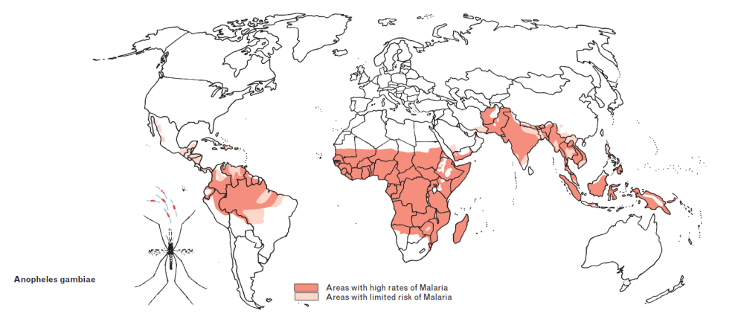
In 2020, there were an estimated 241 million cases of malaria worldwide.[1] The estimated number of malaria deaths stood at 627 000 in 2020.[1] The disease is considered endemic in 13 districts out of 64 in Bangladesh, putting about 14 million people at risk.[2] Among the five species, the most dominant parasite in Bangladesh is P. falciparum [3].
I
Research Background & Motivation
Fig 01: Globally vulnerable areas affected by malaria. [4]

Slide 4
RDT as well as microscopic diagnosis have always been two of the greatest effective methods of malaria diagnosis.[5] In spite of many advanced evaluation techniques for identifying the infection, microscopists at resource constrained regions face challenge in improving the diagnostic accuracy. Also most laboratories or diagnostic facilities are not equipped with standard testing facilities in Bangladesh.
I
Research Background & Motivation

Slide 5

II Objectives
Accelerating the computation process using minimal resources and time.
Implementation a Deep Convolutional Neural Network of malarial infected cells to improve the diagnostic accuracy.
Comparison of training time between CNN and Transfer Learning.

Slide 6
Literature 1
III Related Literature
Improving Malaria Parasite Detection from Red Blood Cell using Deep Convolutional Neural Networks [6]
Method Used:
Custom CNN network from scratch.
Fine tuning on pre-trained model (VGG-16) and CNN as feature extractor with SVM as the classifier.
Contribution:
With the VGG-16 and SVM as a classifier got accuracy of 97.77 %.
Limitation:
High training time.
Low precision.

Slide 7

Literature 2
III Related Literature
Malaria Detection Using Deep Learning[7]
Method Used:
Process the image using thread pool executor for not to
face time straining.
Create the Frozen CNN model (VGG19) and fit the model.
Create the Fine-tuned CNN model(VGG19) and fit the model.
Contribution:
With Fine-tuned VGG-19 got accuracy of 96%.
Limitation:
High training time.
Low accuracy for frozen CNN.

Slide 8
Literature 3
III Related Literature
Transfer Learning with ResNet-50 for Malaria Cell-Image Classification[8]
Method Used:
Consists of 2 layers, Pre- trained ResNet layer and dense layer.
The input data is trained with the pre-trained weights (ResNet-50)
Only Dense layer is learning with back propagation.
Contribution:
Combine resnet layer and dence layer.
Low training time.
Limitation:
Low accuracy and precision score.

Slide 9
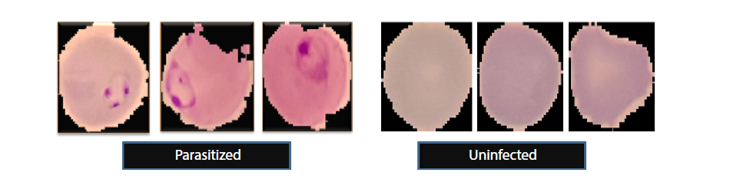
III Dataset
Fig 02. Various form of malaria infected parasite and uninfected red blood cells.
• US National Institute of Health (NIH} Malaria Image Dataset.[9]
• The dataset contains a total of 27,558 cell images with equal instances of parasitized and uninfected cells.

Slide 10
III Methodology
Input Dataset
Data Pre-processing
Data Splitting
Deep CNN Implementation
The aim of the proposed method is to build a model based on deep learning designed to be simpler and more computational than other methods with sufficient training time.

Slide 11
Train and Test Data
III Methodology
The dataset is split into two sets, namely, training & validation and test sets having the ratio of 80:20.
We performed both 5-fold cross validation.
The training dataset is randomly partitioned into
5 equal sized subsets.
4 subsets are used as training data and remaining 1 subset for validation data.

Slide 12
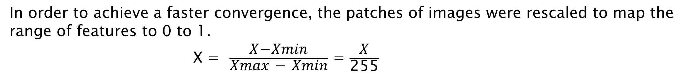
Rescaling
III Methodology
Data Pre-processing
In order to achieve a faster convergence, the patches of images were rescaled to map the range of features to 0 to 1.
X = $\frac{\text{X}\text{−}\text{Xmin}}{\text{Xmax}\text{ − }\text{Xmin}}$ = $\frac{\text{X}}{\text{255}}$
Augmentation
Augmentation Type | Parameters
Zoom | 20%
Rotate | (-25, 25) degrees in range
Shear | 20%
Horizontal Flip | True

Slide 13
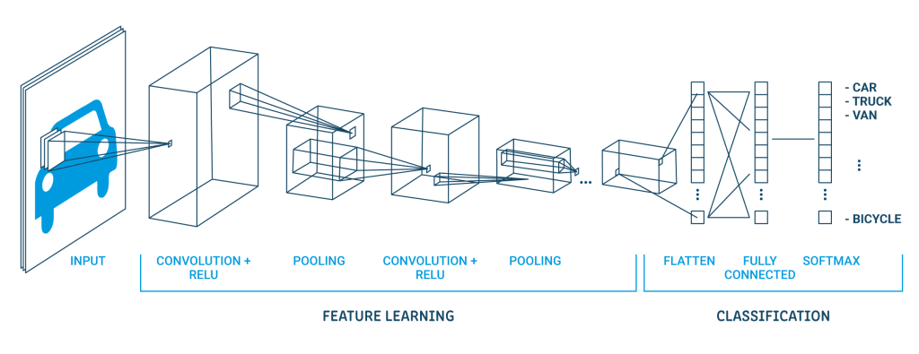
III Methodology
Standard Convolutional Neural Network Architecture
Fig 03. Standard CNN Architecture [10]

Slide 14
III Methodology
CNN
Convolution
Padding
Non Linearity
(ReLu)
Pooling
Flattening
Fully Connected Layer
Convolution of an image with different filters can perform operations such as edge detection, blur and sharpen by applying filters.
Fig 04: Convolution operation [11]

Slide 15
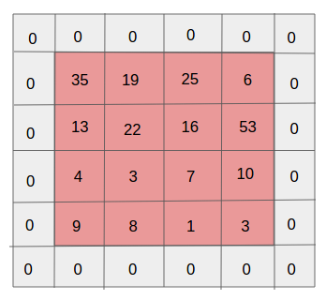
III Methodology
CNN
Convolution
Padding
Non Linearity
(ReLu)
Pooling
Flattening
Fully Connected Layer
Sometimes filter does not fit perfectly fit the input image.
Pad the picture with zeros.
Fig 05: Padding process[12]

Slide 16
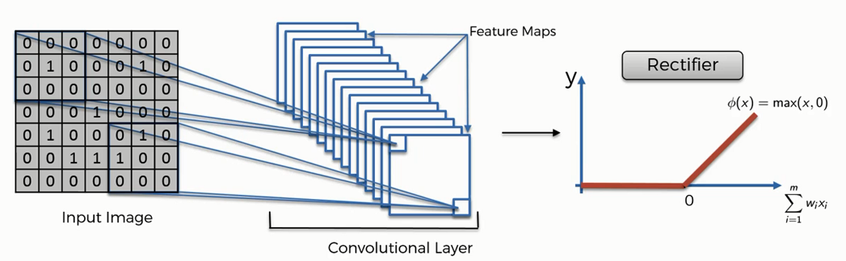
III Methodology
CNN
Convolution
Padding
Non Linearity
(ReLu)
Pooling
Flattening
Fully Connected Layer
ReLU stands for Rectified Linear Unit for a non-linear operation. The output is ƒ(x) = max(0,x).
ReLU’s purpose is to introduce non-linearity in our ConvNet.
Negative values converted to 0.
Fig 06: Relu Activation function [13]

Slide 17
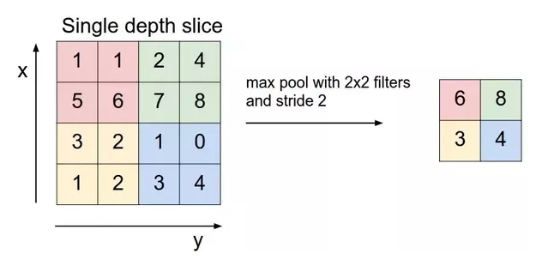
III Methodology
CNN
Convolution
Padding
Non Linearity
(ReLu)
Pooling
Flattening
Fully Connected Layer
Reduce the number of parameters when the images are too large.
Fig 07: Pooling process [14]

Slide 18
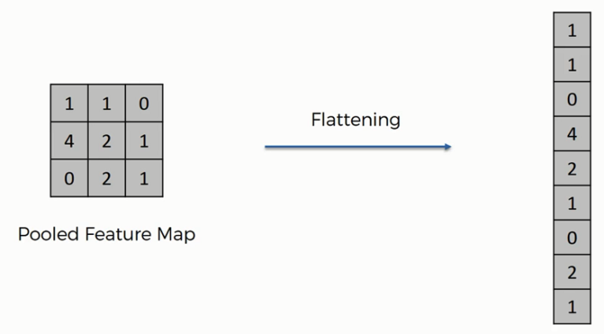
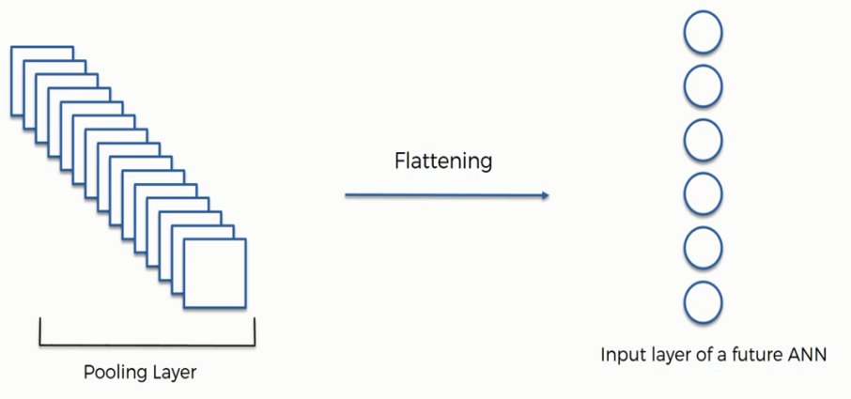
III Methodology
CNN
Convolution
Padding
Non Linearity
(ReLu)
Pooling
Flattening
Fully Connected Layer
Flattened the matrix into vector.
Fig 08: flattening [15]

Slide 19
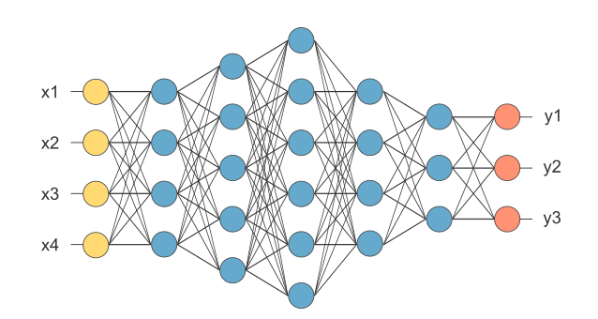
III Methodology
CNN
Convolution
Padding
Non Linearity
(ReLu)
Pooling
Flattening
Fully Connected Layer
The layer is called as FC layer, the flattened vector feed it into a fully connected layer .
Activation function such as softmax to classify the outputs.
Fig 09: Fully Connected layer [15]

Slide 20
III Methodology
Summary of the model Settings
Parameter Name | Type/ Value
Epochs | 50
Batch Size | 64
Optimizer | Adam
Error Function | Binary crossentropy
Input Size | 64 x 64
Pooling | 2 x 2

Slide 21
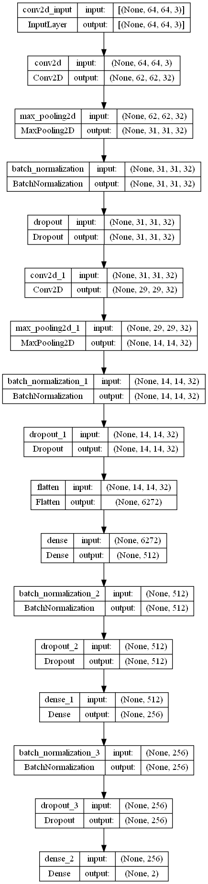
III Methodology
Proposed CNN Model Architecture
Fig 10. Proposed Deep CNN Model Architecture

Slide 22
III Methodology
Convolution Layer | Layer 01: Filter – 32 Kernel Size – 3*3 Activation Function – ReLU Layer 02: Filter – 32 Kernel Size – 3*3 Activation Function – ReLU
2 Pooling Layer | Max-pooling: Kernel Size – 2*2
4 Dropout | 0.2
Dense | 512
Dense | 256
Dense (Output) | 2
Activation | ReLU (Others), softmax (Outputs)

Slide 23
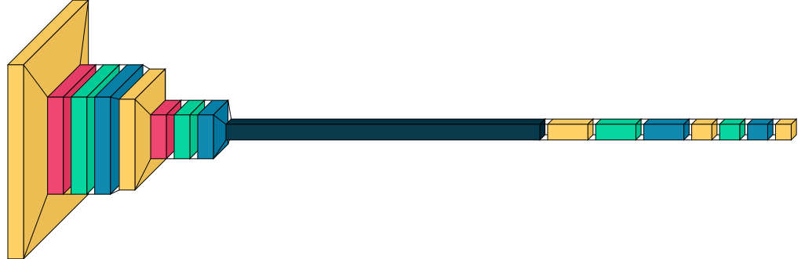
III Methodology
Proposed CNN Model Visualization
conv2D Maxpooling2D Dropout Batch Normalization Flatten Dense
Fig 11. Proposed Deep CNN Model Visualization using visualkeras

Slide 24
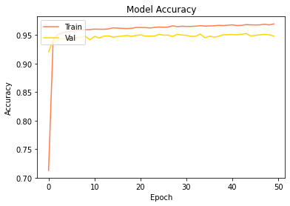
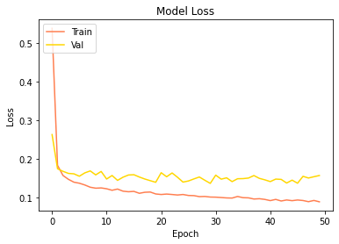
IV Performance Analysis
Metrics | value
Training accuracy | 96.95%
Validation accuracy | 94.81%
Training Loss | 0.0896
Validation Loss | 0.1575
Fig 12. Training and Validation Accuracy of Deep CNN
Fig 13. Training and Validation Loss of Deep CNN

Slide 25
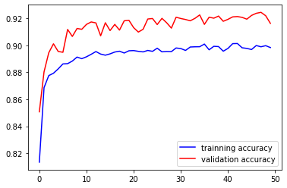
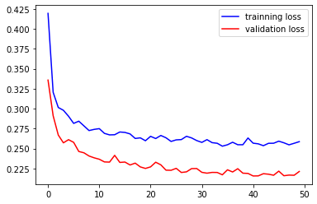
IV Performance Analysis
Fig 14. Training and Validation Accuracy of VGG-19
Fig 15. Training and Validation Loss of VGG-19
VGG-19 model Training and Validation Accuracy / Loss curve for same Malaria Dataset with 50 epochs.

Slide 26
IV Performance Analysis
Normalized Confusion matrix
Parasitized
0.945
0.055
Uninfected
0.039
0.961
Parasitized
Uninfected

Slide 27
IV Performance Analysis
Performance metrices
Accuracy = (TP + TN) / (TP + TN + FP + FN)
Precision = TP / (TP + FP)
Recall = TP / (TP + FN)
F1Score = 2 ∗ (Recall ∗ Precision) / (Recall + Precision)

Slide 28
IV Performance Analysis
Performance Comparison
Model | Test Accuracy | Precession | Recall | F1 Score
CNN(VGG-16) Ex-SVM | 0.9777 | 0.9213 | 0.9515 | 0.9501
Fine-Tuned CNN (VGG-19) | 0.96 | 0.93 | 0.96 | 0.96
CNN (Proposed) | 0.9641 | 0.9569 | 0.9569 | 0.9569

Slide 29
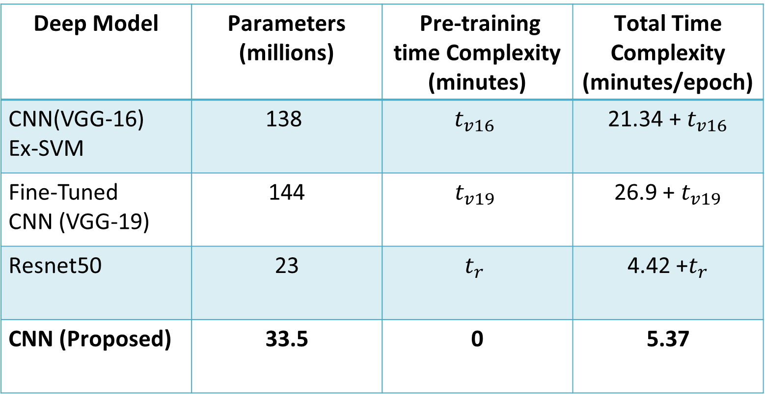
IV Performance Analysis
Comparison of Training Time
Deep Model | Parameters (millions) | Pre-training time Complexity (minutes) | Total Time Complexity (minutes/epoch)
CNN(VGG-16) Ex-SVM | 138 | $$t_{v16}$$ | 21.34 + $t_{v16}$
Fine-Tuned CNN (VGG-19) | 144 | $$t_{v19}$$ | 26.9 + $t_{v19}$
Resnet50 | 23 | $$t_{r}$$ | 4.42 +$t_{r}$
CNN (Proposed) | 33.5 | 0 | 5.37
Machine Configuration:
Intel Core i5 7th Gen
2GB NVIDIA GPU
where $t_{v16}$, $t_{v19}$,and $t_{r}$ refer to the pre-training time complexity for the VGG-16, VGG-19,Resnet50, respectively.

Slide 30

Publication
The research work titled “Malaria Parasite Detection using CNN Architecture” was submitted to the 4th International Conference on Electrical, Computer & Telecommunication Engineering (ICECTE) in 2022 under the supervision of Mahit Kumar Paul Sir, Assistant Professor, Department of CSE, RUET. This thesis work is an extension study of this work.

Slide 31
Future Work
Try image segmentation and image localization techniques to cluster the red globular structures.
Deploy the model in more convenient way and showcase the model in production.
And try to run this model in various dataset and see how it behave with new datasets.

Slide 32
References
[1] World Health Organization, “Malaria,” https://www.who.int/news-room/fact-sheets/detail/malaria.
[2] Haque, Ubydul, Hans J. Overgaard, Archie CA Clements, Douglas E. Norris, Nazrul Islam, Jahirul Karim, Shyamal Roy et al. "Malaria burden and control in Bangladesh and prospects for elimination: an epidemiological and economic assessment." The Lancet Global Health 2, no. 2 (2014): e98-e105.
[3] Haque, Ubydul, Syed Masud Ahmed, Shahed Hossain, Mamun Huda, Awlad Hossain, Mohammad Shafiul Alam, Dinesh Mondal, Wasif Ali Khan, Mohammod Khalequzzaman, and Rashidul Haque. "Malaria prevalence in endemic districts of Bangladesh." PLoS One 4, no. 8 (2009): e6737.
[4] International Association for Medical Assistance to travellers. (n.d.).
https://www.iamat.org/assets/images/IAMAT_MalariaChart_map_July2017_996x441.png
[5] Makanjuola, R.O. and Taylor-Robinson, A.W., Improving Accuracy of Malaria Diagnosis in Underserved Rural and Remote Endemic Areas of Sub-Saharan Africa: A Call to Develop Multiplexing Rapid Diagnostic Tests. Scientifica, 2020, https://doi.org/10.1155/2020/3901409.

Slide 33
References
[6] Rahman, Aimon, Hasib Zunair, M Sohel Rahman, “Improving Malaria Parasite Detection from Red Blood Cell using Deep Convolutional Neural Networks”, 2019, https://doi.org/10.48550/arXiv.1907.10418
[7] Shekar, Gautham, et al. “Malaria Detection Using Deep Learning.” 2020 4th International Conference on Trends in Electronics and Informatics (ICOEI)(48184), 2020, https://doi.org/10.1109/icoei48184.2020.9143023.
[8] Reddy, A. Sai, and D. Sujitha Juliet. “Transfer Learning with Resnet-50 for Malaria Cell-Image Classification.” 2019 International Conference on Communication and Signal Processing (ICCSP), 2019, https://doi.org/10.1109/iccsp.2019.8697909.
[9] Know Your Data, ”Malaria”, https://knowyourdata-tfds.withgoogle.com/#tab=STATS&dataset=malaria
[10] MathWorks, “Introducing Deep Learning with MATLAB”, https://www.mathworks.com/campaigns/offers/next/deep-learning-ebook.html.

Slide 34
References
[11] L. Yin, “A summary of neural network layers,” Jul 2018. [Online]. Available: https://medium.com/machine-learning-for-li/different-convolutional-layers-43dc146f4
[12] “A comprehensive guide to convolutional neural networks — the eli5 way | by sumit saha | towards data science,” https://towardsdatascience.com/44 a-comprehensive-guide-to-convolutional-neural-networks-the-eli5-way-3bd2b1164a53,
(Accessed on 10/13/2022)..
[13] “CNN and softmax,” Andrea Perlato. [Online]. Available: https://www.andreaperlato.com/aipost/cnn-and-softmax/. [Accessed: 22-Oct-2022].
[14] “Understanding of convolutional neural network (cnn) — deep learning | by prabhu | medium,” https://medium.com/@RaghavPrabhu/ understanding-of-convolutional-neural-network-cnn-deep-learning-99760835f148,
(Accessed on 10/13/2022).
[15] “Applied deep learning - part 4: Convolutional neural networks | by arden dertat | towards data science,” https://towardsdatascience.com/ applied-deep-learning-part-4-convolutional-neural-networks-584bc134c1e2, (Accessed
on 10/13/2022)..

Slide 35
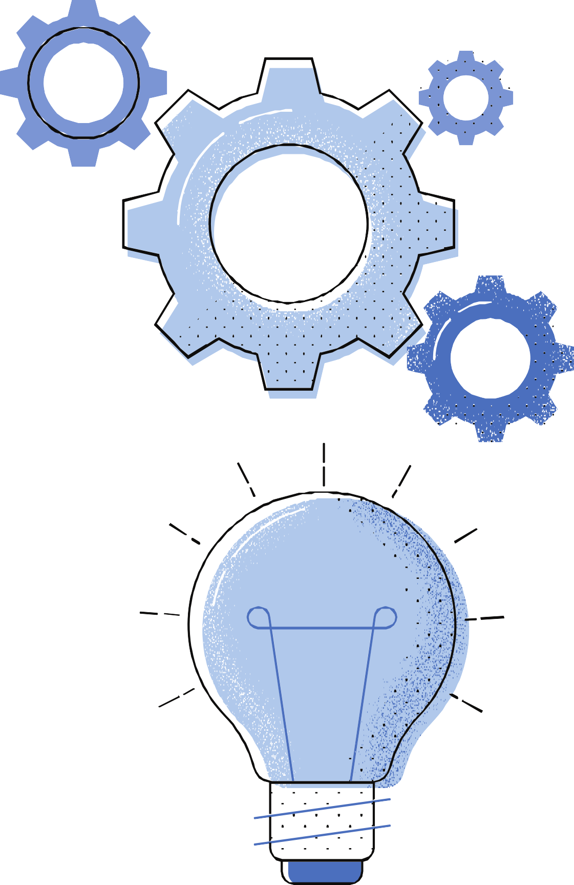
Thank you
for listening!

